Slide 1
Native Signal Processing
Prof. Christian Langen
Lucía Mandujano 68591
Yunus Emin Yazici 68571
Zhilun Li 68572
17/02/2022

Slide 2
PROJECTS
Audio Effects: Reverberation and Flanger
Signal Generator
VS Code Template for NSP Project*

Slide 3
Audio Effects: Reverberation and Flanger
Write a program that is reading a signal from the microphone or line-in input, optionally adds a reverberation (repeated echo) or flanger effect, and outputs the signal on the line-out output.
Notes:
WHAT IS THE OBJECTIVE OF THE PROJECT

Slide 4
What is the reverberation?
Reverberation (also known as reverb), in acoustics, is a persistence of sound, or echo after a sound is produced. Reverberation is created when a sound or signal is reflected causing numerous reflections to build up and then decay as the sound is absorbed by the surfaces of objects in the space. This is most noticeable when the sound source stops but the reflections continue, their amplitude decreasing, until zero is reached.
Notes:
Reverberation is a continuing effect; a repercussion and it occurs with accumulation of sound waves in a space. When the sound source stops but the reflections continue, their amplitude decreasing, until zero is reached. Basically when we had impulse input we got decreasing impulse response as output.

Slide 5

Reverberation Example

Slide 6
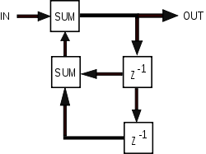
IIR Filter (Infinite impulse response)
The output from the filter is computed by using the current and previous inputs and previous outputs.
Because the filter uses previous values of the output, there is feedback of the output in the filter structure.
Notes:
-To get understand the Reverberation we should also understand the IIR Filter. -The output of the filter is computed by using the current and previous inputs and previous outputs. -The impulse response is “infinite” because there is feedback in the filter; if you put in an impulse, an infinite number of non-zero values will come out.

Slide 7
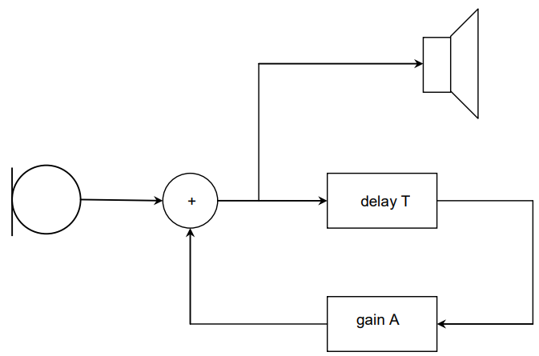
y[k]=x[k]+αy[k−N]
The reverberation effect occurs due to a IIR-filter with the difference equation
The parameter α is the gain and N is the delay.
The delay should be adjustable between
Tmin = 0s and Tmax = 1s
The gain between
A min = - 60 dB and
A max = 0 dB.
Notes:
Boundry condition for reverberation: The parameter

Slide 8

Basic principles and MATLAB simulation
For the reverberation system, the system function is
The parameter α is the gain, N is the delay.

Slide 9

In MATLAB, represent the coefficient of the numerator by creating an array with only one element, and represent that of the denominator by creating an array with two elements.
Here, choose the gain α to be 0.7 and the delay factor N to be 1
Notes:
Representing the mathematical expression in Matlab, Here, choose the gain α to be 0.7 and the delay factor N to be 1

Slide 10
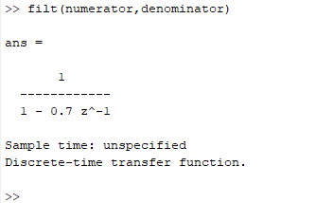
The MATLAB command filt can be used to generate a discrete-time transfer function.

Slide 11
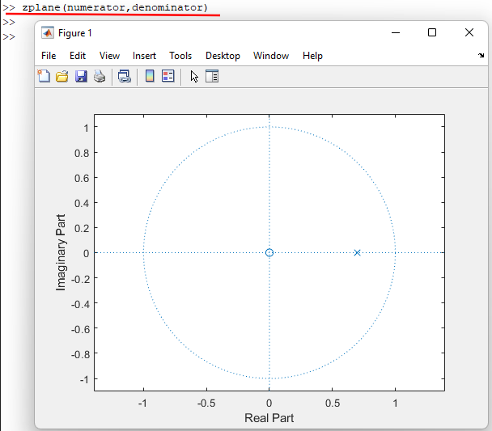
The MATLAB command zplane provides the z-plane plot for discrete-time systems.
Notes:
-A digital filter is stable if and only if all the poles of the filter lie inside the unit circle in the z plane.

Slide 12
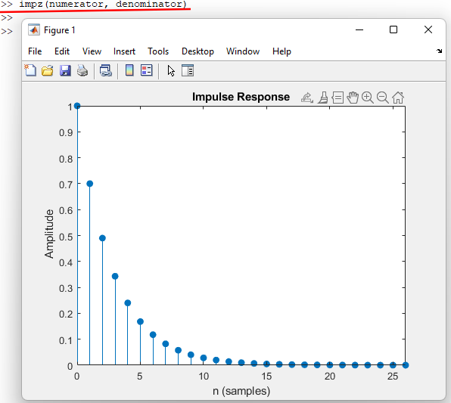
The MATLAB command impz gives out the impulse response of the transfer function.
Notes:
Impulse response is the system response to the impulse signal.

Slide 13
System responses with different delay factors and gains.
https://github.com/holdenzlL/reverberation_NSP

Slide 14
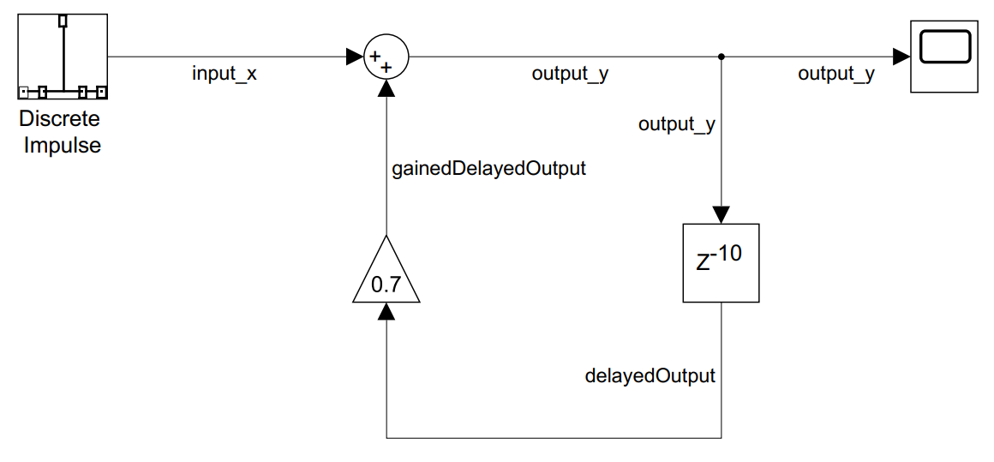
Simulation with Simulink
y[k]=x[k]+αy[k−N]
For the component Discrete Impulse, the sample time is set to be 1/48000.
Notes:
1. Read in the input signal and store the value into input_x
2. Calculate the value of output_y, output_y = input_x + gainedDelayedOutput
3. Output the value of output_y
4. Do delay operation and get the value of delayedOutput
5. Multiply the value of delayedOutput by α to get the value of gainedDelayedOutput

Slide 15
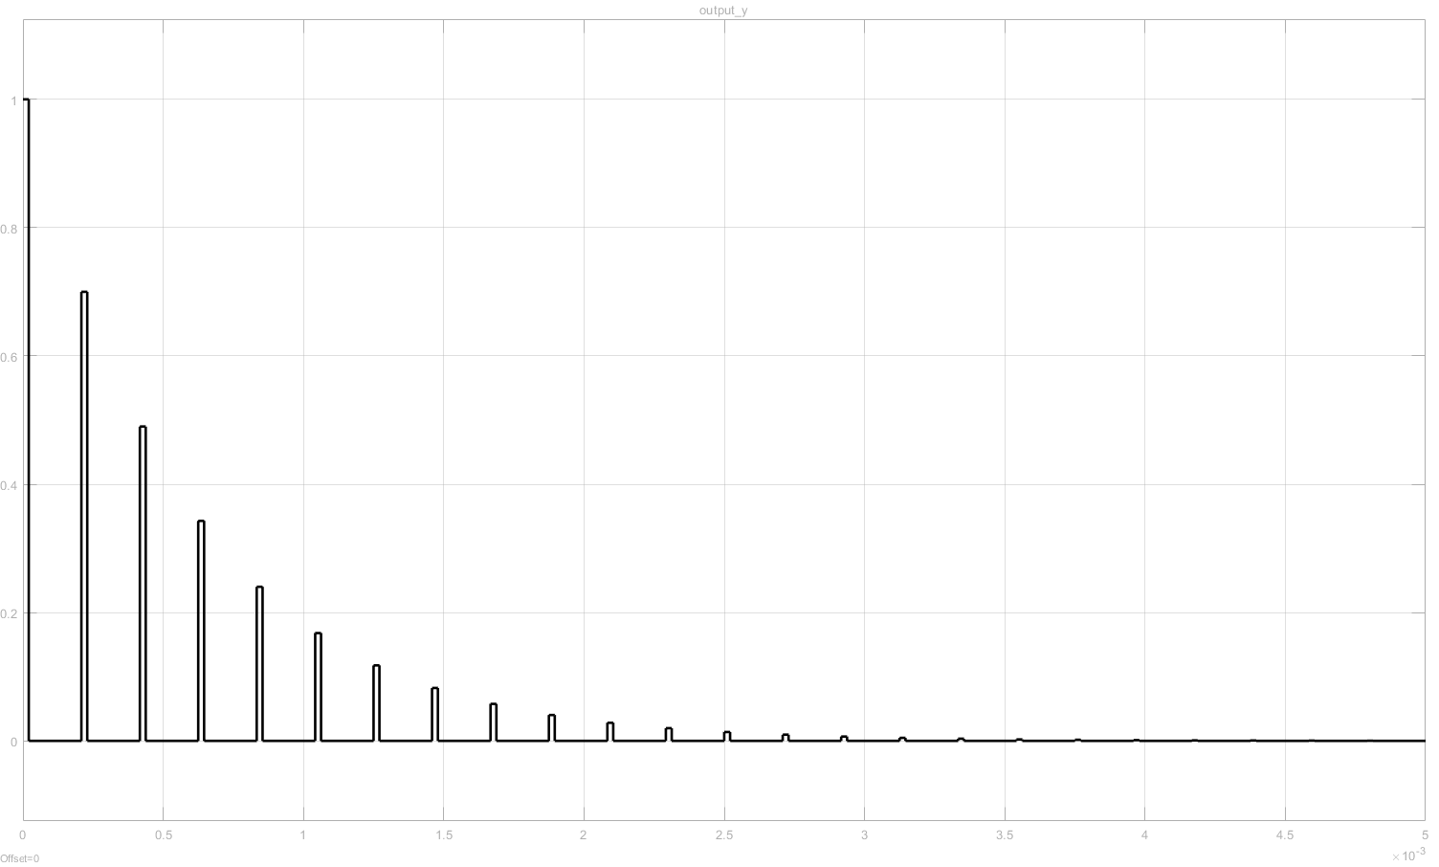
The output waveform of the oscilloscope is shown below

Slide 16
Simulation with Simulink
y[k]=x[k]+αy[k−N]
For the component Discrete Impulse, the sample time is set to be 1/48000.
Notes:
1. Read in the input signal and store the value into input_x
2. Calculate the value of output_y, output_y = input_x + gainedDelayedOutput
3. Output the value of output_y
4. Do delay operation and get the value of delayedOutput
5. Multiply the value of delayedOutput by α to get the value of gainedDelayedOutput

Slide 17
Simulation with Simulink
y[k]=x[k]+αy[k−N]
Using DMA for input and output
Adjustable Buffer
Adjustable Gain
For the component Discrete Impulse, the sample time is set to be 1/48000.
Notes:
1. Read in the input signal and store the value into input_x
2. Calculate the value of output_y, output_y = input_x + gainedDelayedOutput
3. Output the value of output_y
4. Do delay operation and get the value of delayedOutput
5. Multiply the value of delayedOutput by α to get the value of gainedDelayedOutput

Slide 18
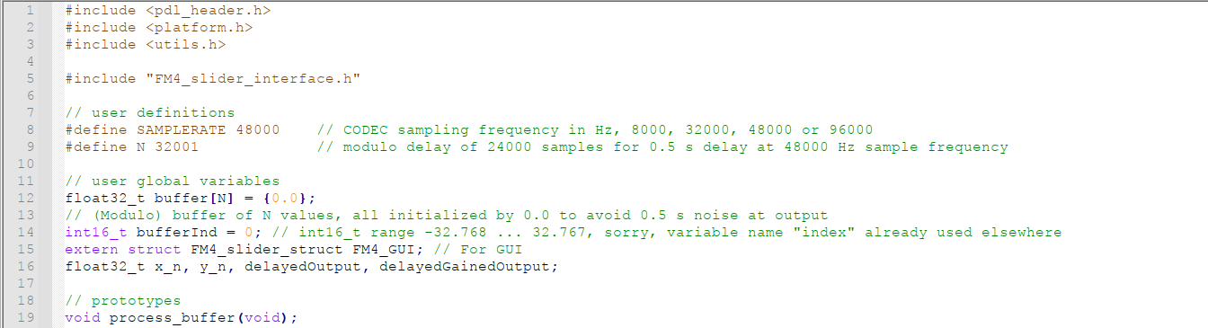
Reverberation Coding Part

Slide 19
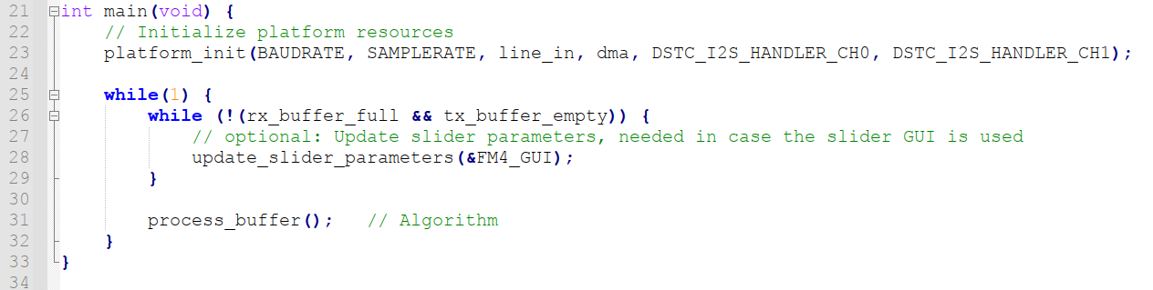

Slide 20
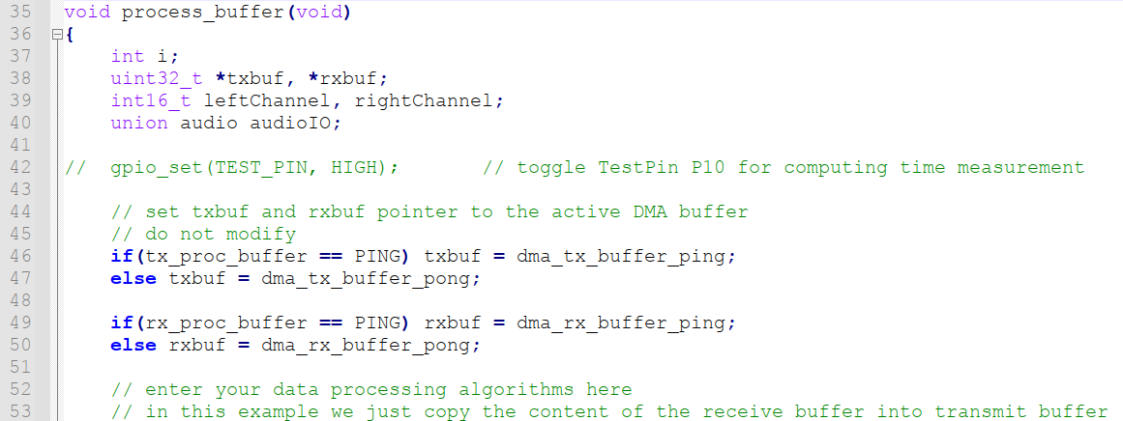

Slide 21
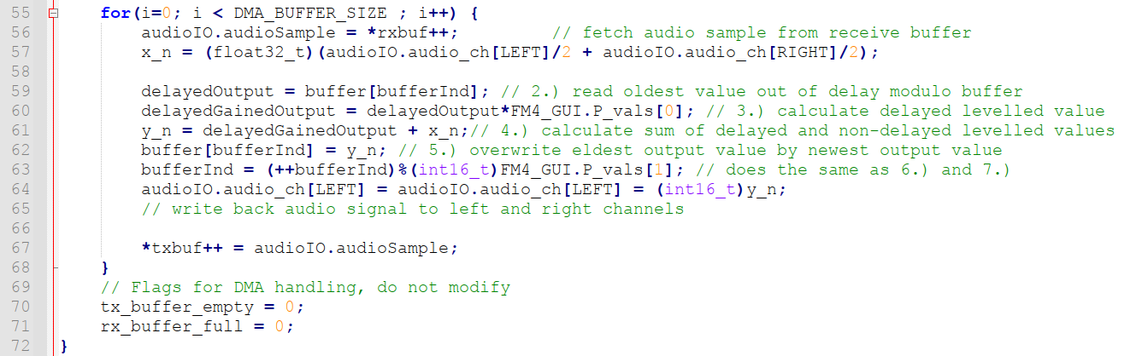

Slide 22
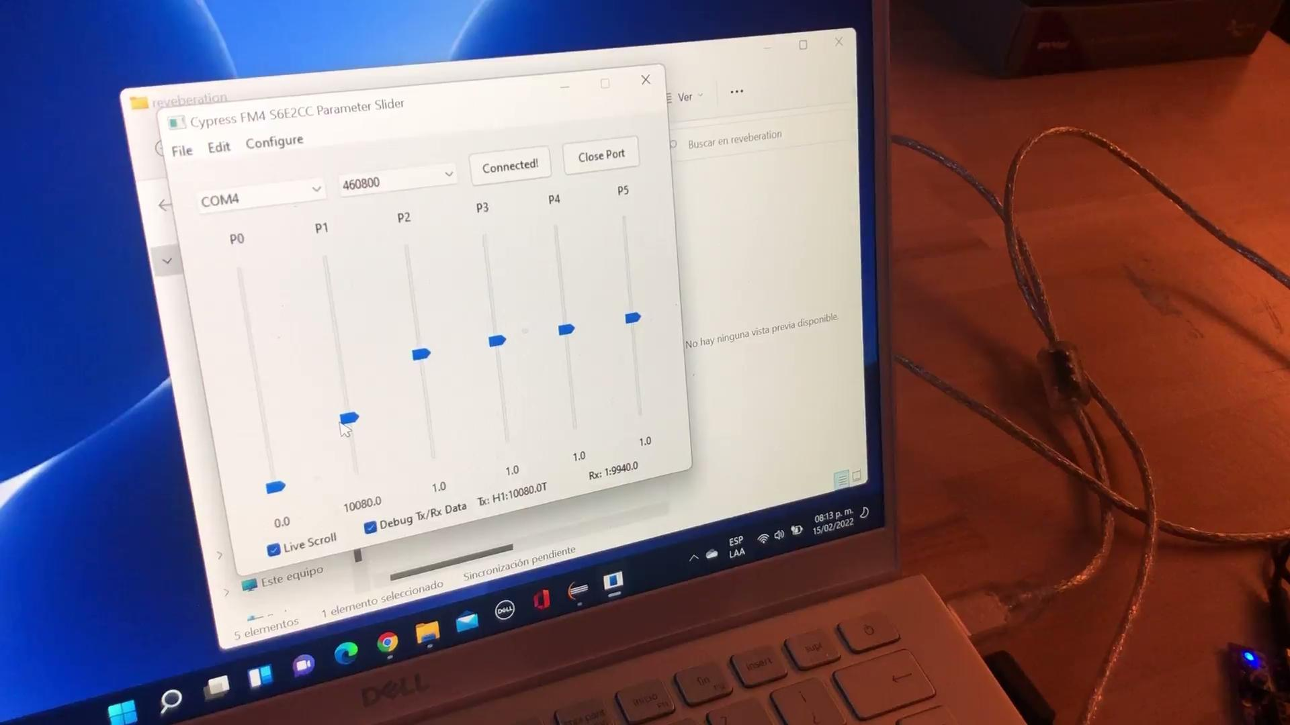
Reverberation Video
Notes:
When we are testing the project sometimes communication has problem, sometimes computer has problem so we decided to shoot a video.

Slide 23
The MATLAB command impz gives out the impulse response of the transfer function.
Notes:
Impulse response is the system response to the impulse signal.

Slide 24
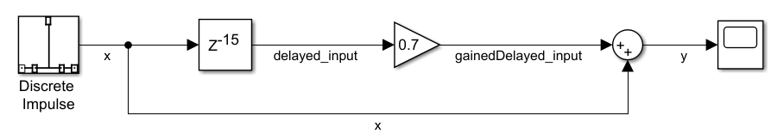
What is Flanger Effect ?
Flanging is an audio effect produced by mixing two signals together. The input signal and a delayed gained input signal, to generate an output.
Notes:
The flanger effect is an audio effect that is produced by mixing two signals together with a delay between each other.

Slide 25
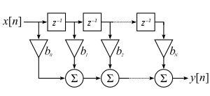
FIR Filter (Finite Impulse Response)
In signal processing, a finite impulse response (FIR) filter is a filter whose impulse response (or response to any finite length input) is of finite duration, because it settles to zero in finite time.
Notes:
This effect can be done by the means of an FIR filter, which is a finite impulse response filter.
As shown in the picture, the filter consists on adding a current input signal with it´s former values, to generate an output that contains the original signal and a delayed version of itself.
In comparison to the IIR filter, the input signal gets delayed, and not the output signal.

Slide 26
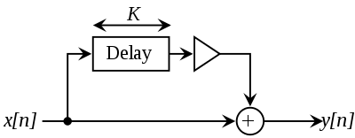
Comb Filter
In signal processing, a comb filter is a type of FIR filter implemented by adding a delayed version of a signal to itself, causing constructive and destructive interference. The frequency response of a comb filter consists of a series of regularly spaced notches, giving the appearance of a comb.
Notes:
The comb filter is a specific type of FIR filter which is used in the flanger effect, and it has the same properties and behavior as the FIR filter.

Slide 27
The Flanger-effect is caused by a comb filter with the difference equation:
y[k]=x[k]+α⋅x[k−N]
Where,
α = amplitude of the delayed signal, strength of the filter and of flanger effect.
N = delay time between input signal and delayed input signal. (delay factor)
Notes:
The system of the flanger-effect is described by the following difference equation, where it is stated that the output is the addition of the input plus a gained delay of the input with a certain gain (alpha) and a certain buffer size N.

Slide 28

System Function
For the system of flanger-effect, the system function is
Notes:
We can get the system function out of the difference equation by doing the Ztransform of the difference equation. Shown in the current slide.

Slide 29
In MATLAB, represent the coefficient of the numerator by creating an array with only one element, and represent that of the denominator by creating an array with two elements.
Here, choose the gain α to be 0.7 and the delay factor N to be 1
Notes:
For the MATLAB simulation, the following system equation was implemented with an alpha of 0.7, and an N of 1.

Slide 30
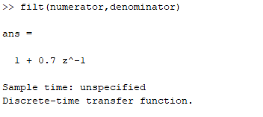
The MATLAB command filt can be used to generate a discrete-time transfer function.
Notes:
The equation was simulated in the same way as for the reverberation.

Slide 31
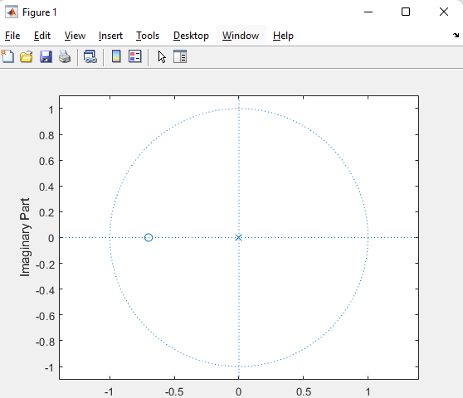
The MATLAB command zplane provides the z-plane plot for discrete-time systems.
Notes:
By plotting the Z-plane we can see that the pole is located at the origin.

Slide 32
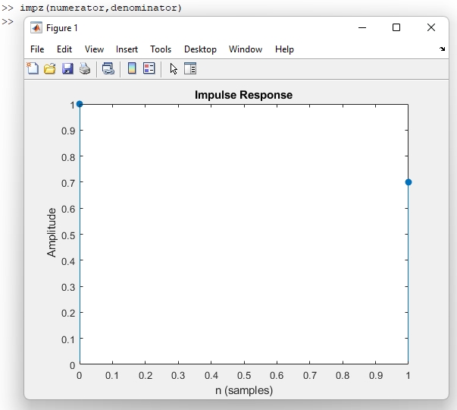
The MATLAB command impz gives out the impulse response of the transfer function.
Notes:
And the impulse response shows two pulses, the original signal with an amplitude of 1, delayed ba 1 unit, with an amplitude of 0.7.

Slide 33
Simulation with Simulink
The Simulink simulation of the Flanger system is shown below.
For the component Discrete Impulse, the sample time is set to be 1/48000.
Notes:
For the simulink simulation this diagram was constructed, in which the logic follows the system equation

Slide 34
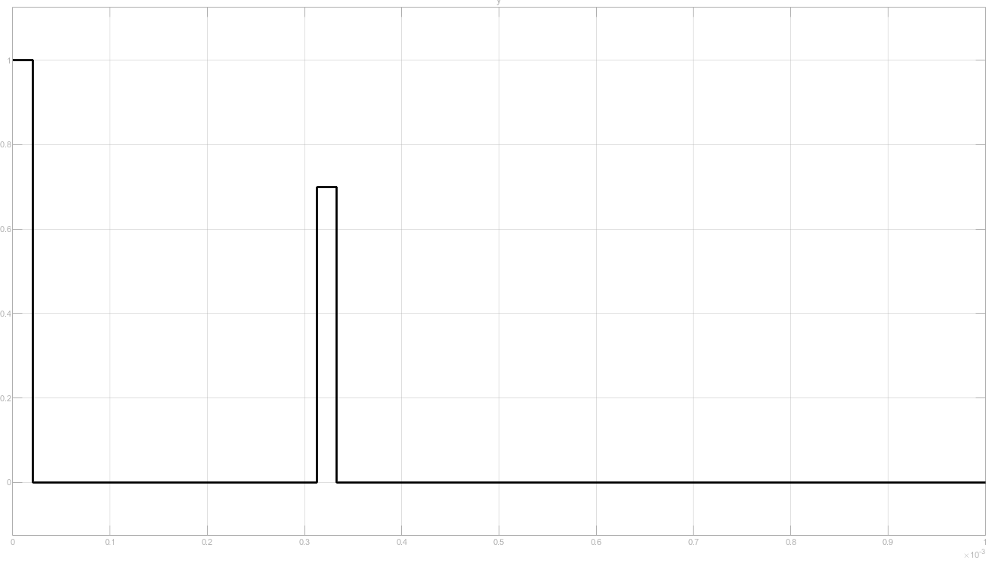
The output waveform of the oscilloscope is shown below.
Notes:
By applying this logic, the following output waveform was obtained, which is as expected.

Slide 35
Simulation with Simulink
The Simulink simulation of the Flanger system is shown below.
For the component Discrete Impulse, the sample time is set to be 1/48000.

Slide 36
Simulation with Simulink
The Simulink simulation of the Flanger system is shown below.
For the component Discrete Impulse, the sample time is set to be 1/48000.
Using DMA for input and output
Adjustable Buffer

Slide 37
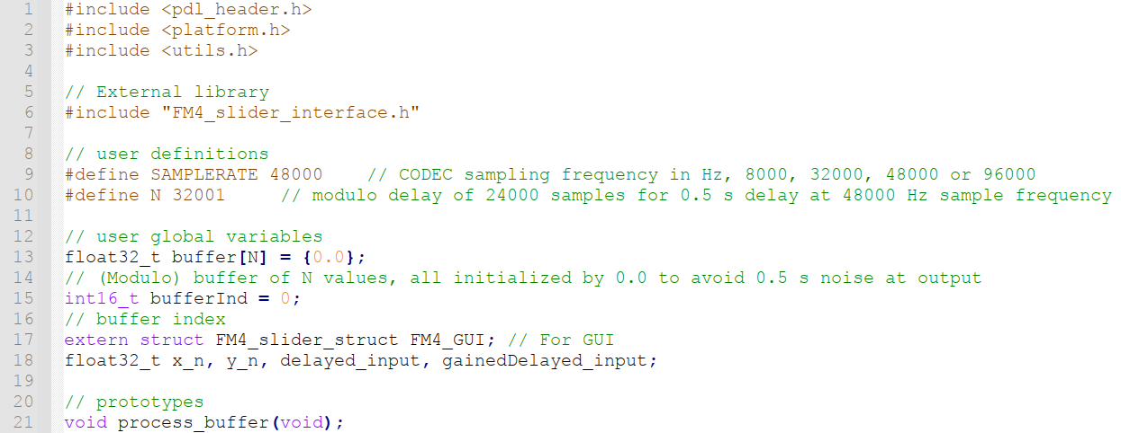
Flanger Coding Part

Slide 38
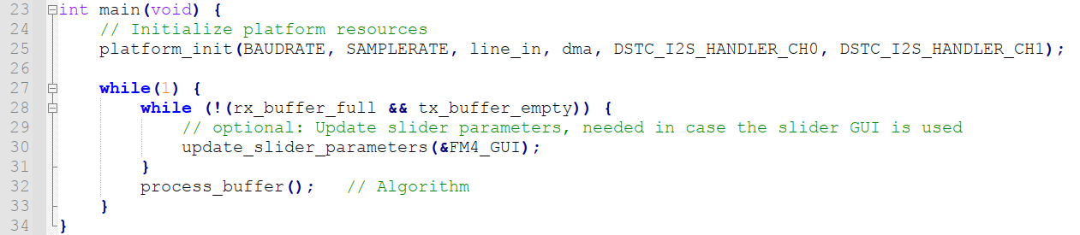

Slide 39
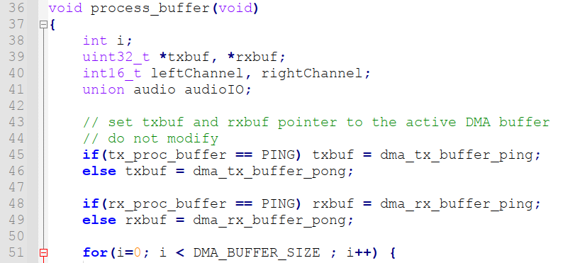

Slide 40
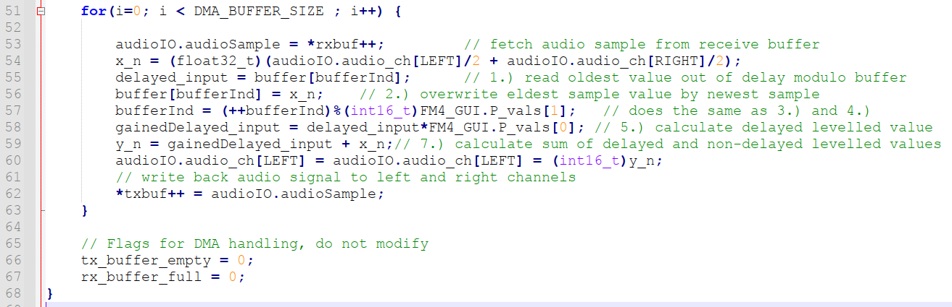

Slide 41

Flanger Video
Notes:
For implementation we read in the signal using the line-in input and vary the parameters using the GUI.
P0 = Amplitude
P1 = N delay factor
At first P0 is zero so no flanger effect, even if the delay factor is changing.

Slide 42
Signal Generator
Write a program that generates harmonic oscillations in two ways:
IIR filter
By direct digital synthesis (Look up table and calculation)
For the IIR filter with poles on the unit circle. The frequency should be adjustable.

Slide 43
Principle
One method of sine-wave generation is based on a IIR filter that employs the principle of oscillation. (pole on the unit circle, system between the stable and unstable)

Slide 44

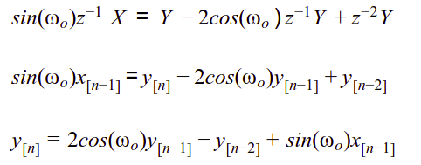
Principle IIR Filter and Derivation of System Function
Z-transform of sinusoidal wave
Convert system function into difference equation
Notes:
We want to impulse response of the system to be sinusoidal. We take the sinus inverse Z transformation.

Slide 45

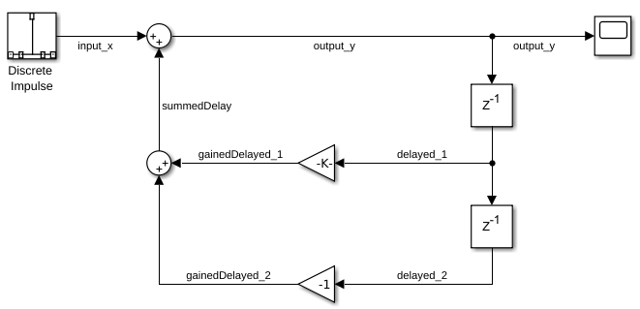
Matlab Simulink

Slide 46
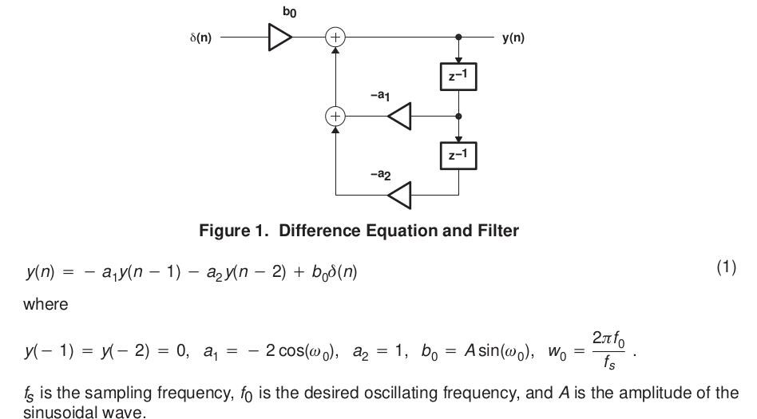

Slide 47
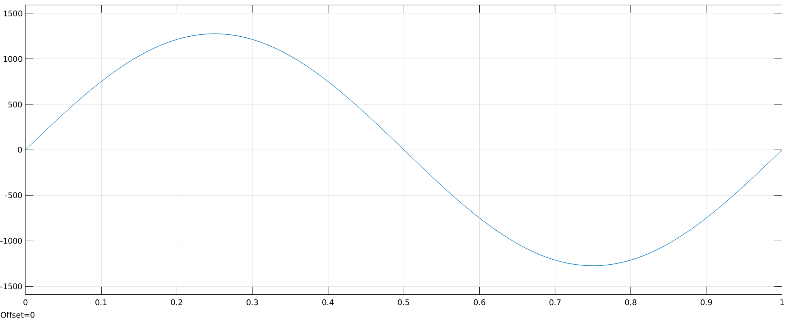
Output_y for sample rate 1/8000

Slide 48
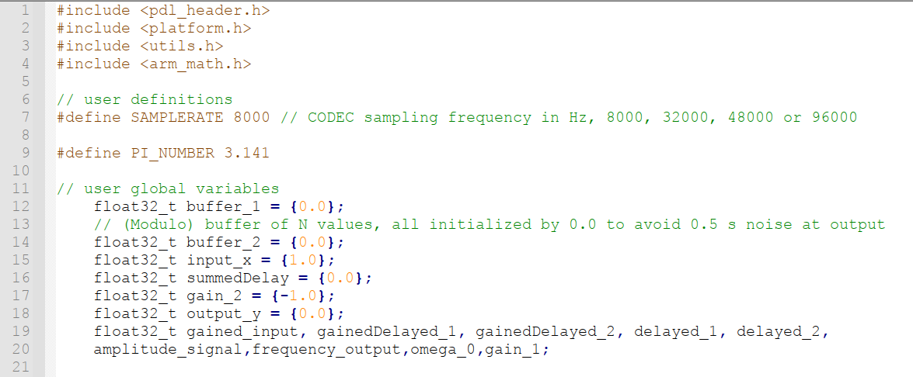
IIR Filter Coding Part

Slide 49
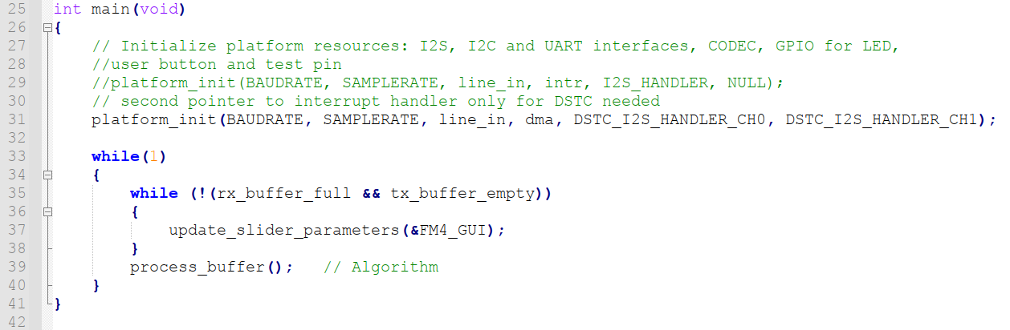

Slide 50
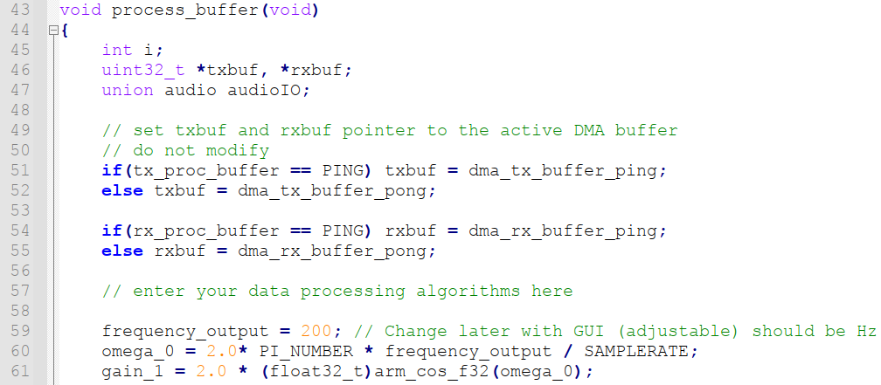
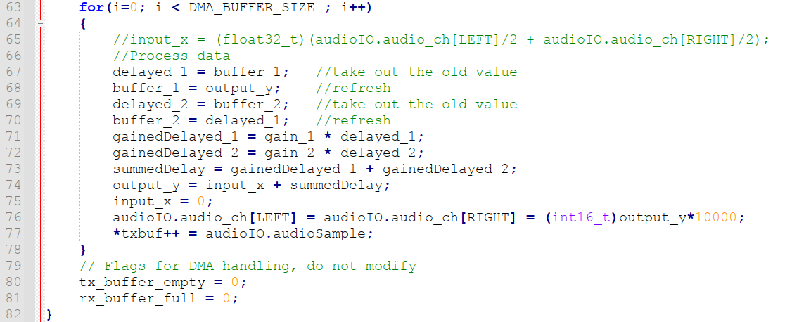

Slide 51
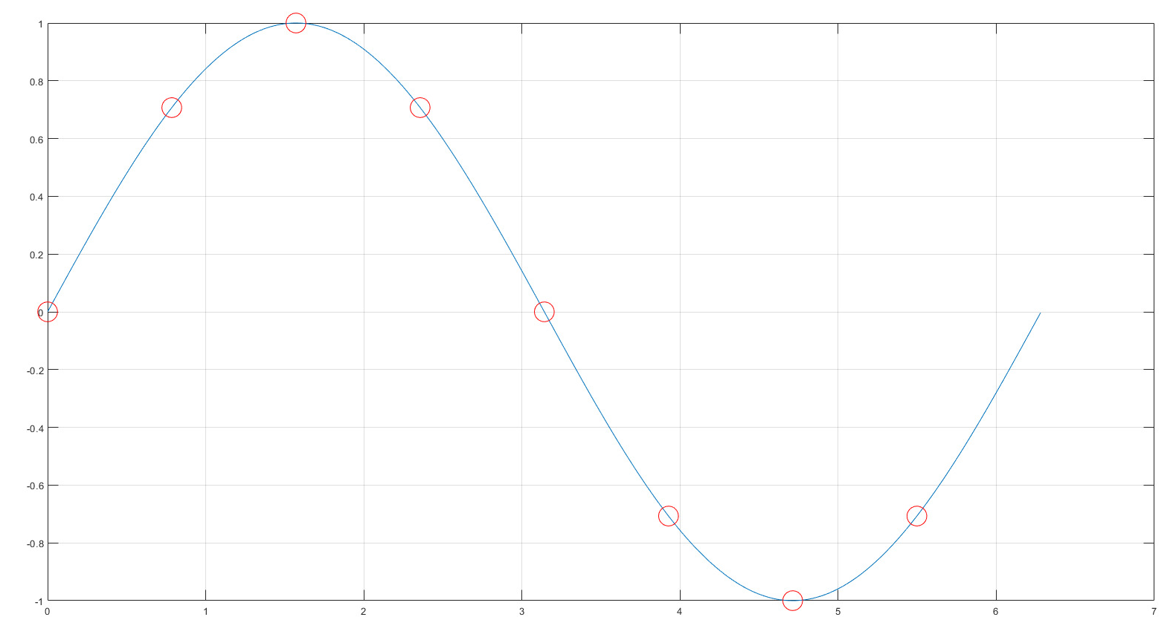

Look up table
Another approach of generating a sine wave is based on a look-up table. Starting with an analog sine wave expression and taking its samples at a fixed regular interval at the rate n. (n is the table size).
Output frequency of the sine wave depends on sample rate and look up table size.
Notes:
The lookup table is a different method to generate a sine wave(such as the sinosoidal signal).
Output frequency of the sine wave depends on sample rate and look up table size.

Slide 52
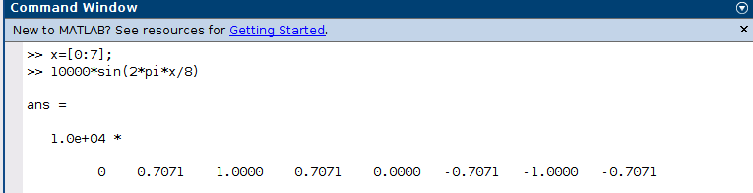
Matlab Calculation for first 8 value of sinus
Notes:
The table size is defined, in this case is an 8 value table.
And then for each position of the table, the sine value corresponding to each position is obtained. Which is then provided in the array. As a reference for the sine wave behavior.

Slide 53
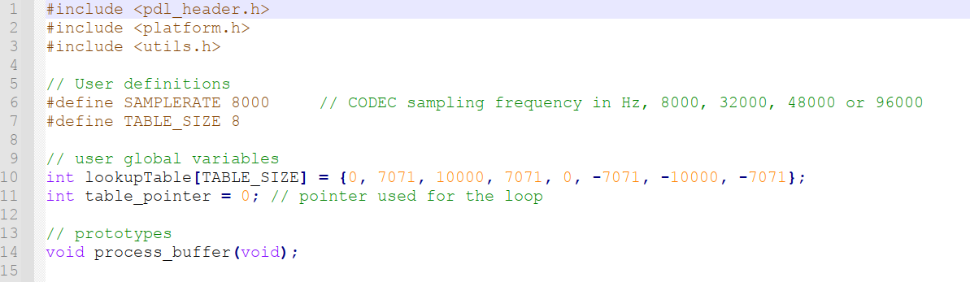
Look up table Coding Part

Slide 54
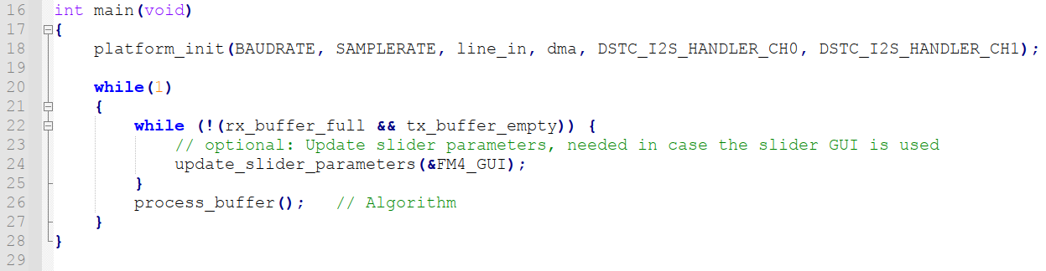

Slide 55
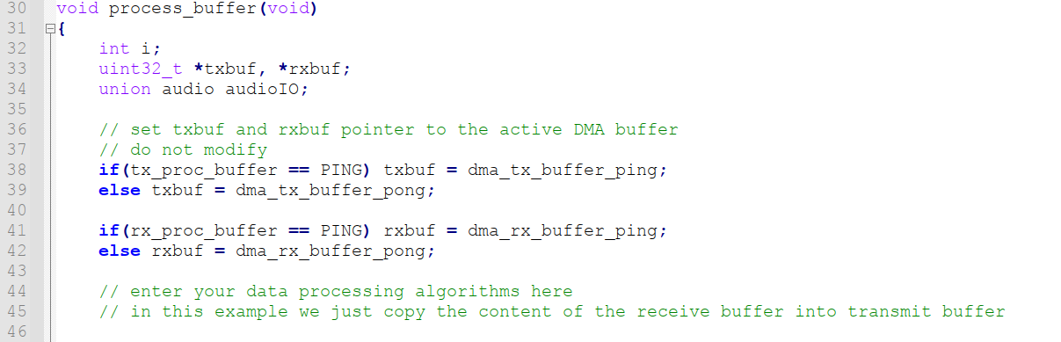

Slide 56
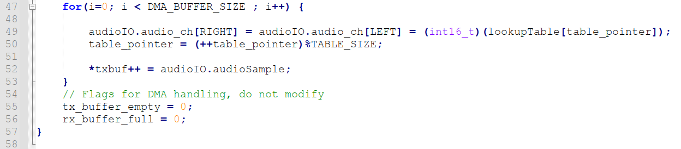

Slide 57
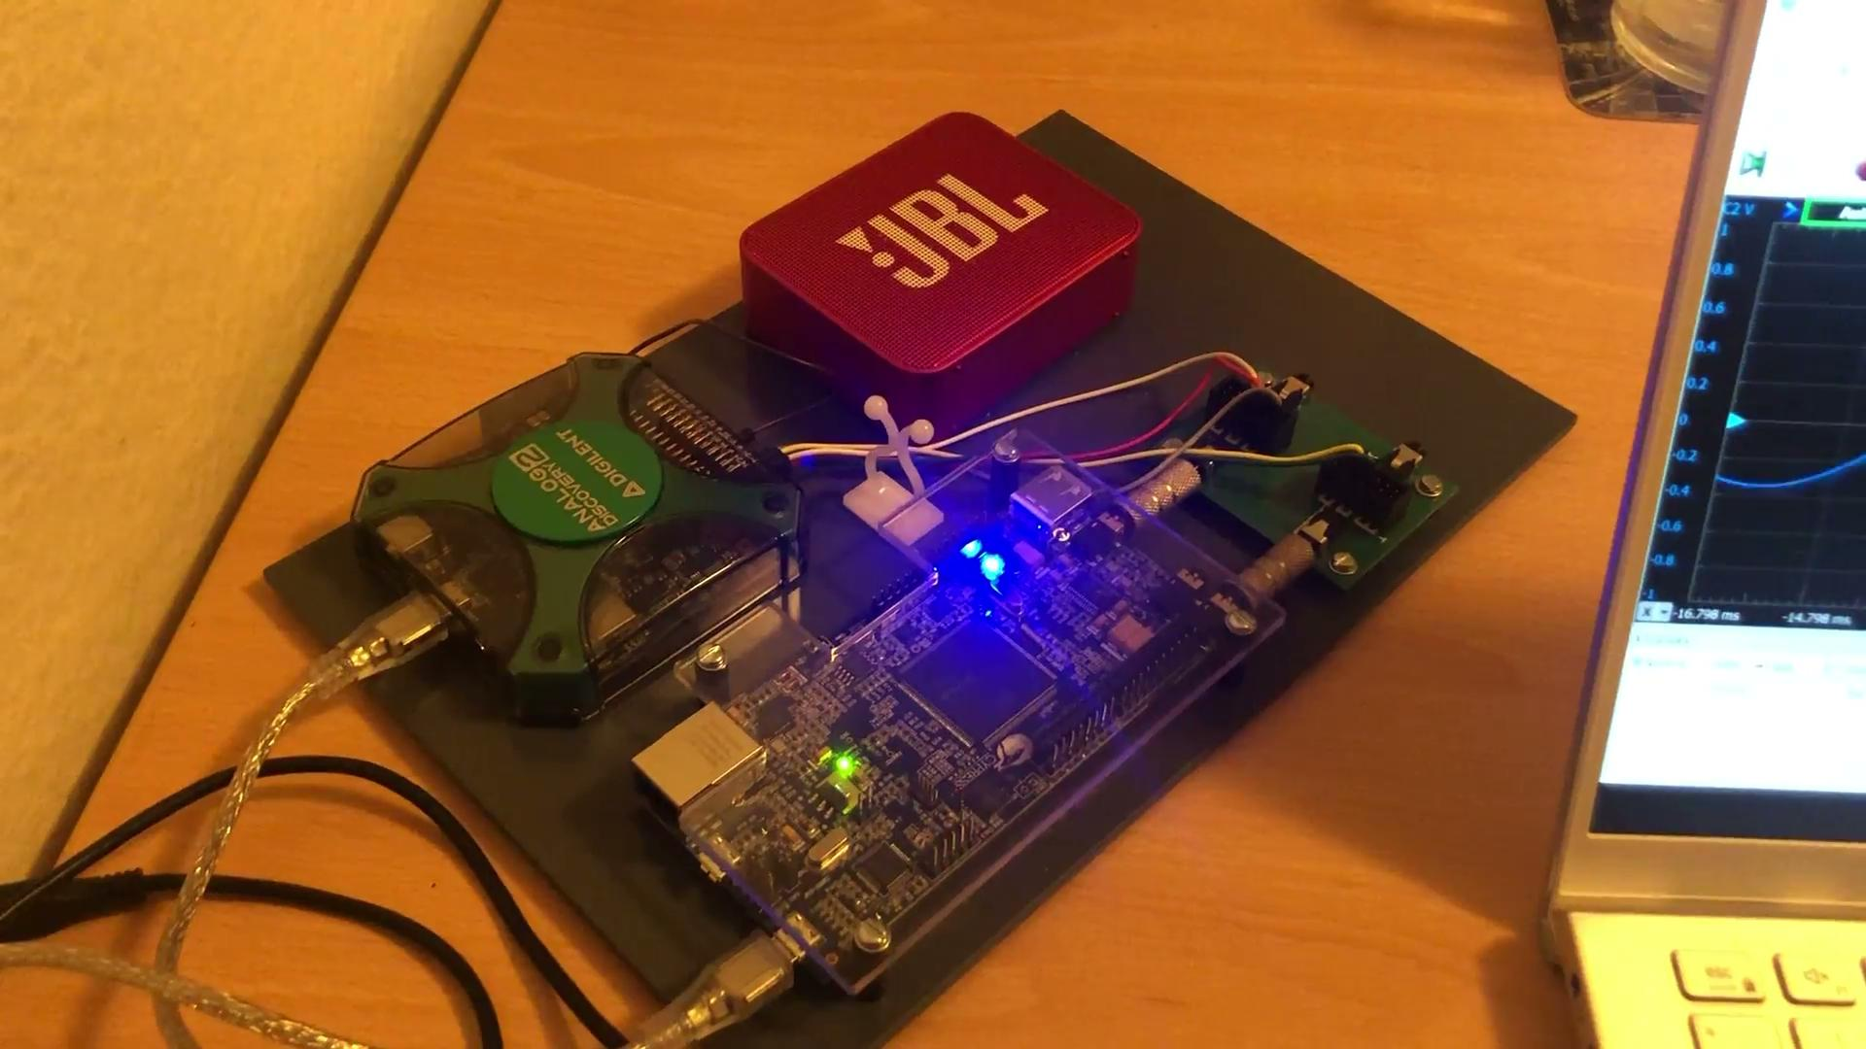
Look up table demonstration
Notes:
At first there’s no signal because amplitude is zero.
We read the signal with the scope
Then by increasing the amplitude and the frequency, the signal changes, and we can proof with the cursors that the frequency of the signal is equal to the one we desire.
If he asks: 100 Hz to 1000 Hz

Slide 58
VS Code Template for NSP Project
Content
Prerequisite
How to clone the Repository in the VSCode
How to build the project
How to burn the program (.elf) file onto the board
Archive: How to use the terminal to build the project
Reference
https://github.com/holdenzlL/NSP_Template-for-VS-Code

Slide 59
1. Prerequisite
1. Have gnu arm building tools installed/downloaded.
2. Have make.exe in the system environment variable PATH

Slide 60
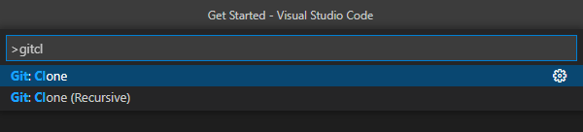
2. How to clone the Repository in the VSCode
Open VSCode and then Open the command palette with the key combination of Ctrl + Shift + P.
At the command palette prompt, enter gitcl, select the Git: Clone command, and press Enter.
Enter the URL in the Repository URL field.
Choose the desired location for Repository.

Slide 61
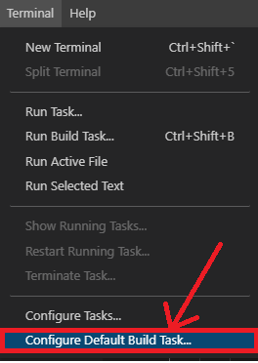
3. How to build the project
There are two build tasks in the ./.vscode/tasks.json, one is to build the project, the other is to clean the project first (delete everything in the build) and then build.
Go to Terminal -> Configure Default Build Task... -> Select the preferred on
After configuration, press CTRL + SHIFT + B to build the project

Slide 62
4. How to burn the program (.elf) file onto the board
Open the file ./vscode/launch.json to adjust the name of the executable files and the relative paths.
After adjustment, use F5 or the menu Run > Start Debugging to start a debug session.

Slide 63
5. Archive: How to use the terminal to build the project
Open the VSCode explorer (ctrl+shift+E), right-click the "build" folder, select "Open in integrated terminal".
go to the folder ./build, and open the terminal.
configure the project by running the command " cmake -DCMAKE_MAKE_PROGRAM=make.exe -G "Unix Makefiles" .. " at the path ./build
build the project by running the command " make " at the path ./build

Slide 64
6. Reference
https://mcuoneclipse.com/2021/05/01/visual-studio-code-for-c-c-with-arm-cortex-m-part-1/

Slide 65
References
About Lookup Table Blocks - MATLAB & Simulink. (2022). Mathworks.Com. https://www.mathworks.com/help/simulink/ug/about-lookup-table-blocks.html
IIR Filters - an overview | ScienceDirect Topics. (2012). Sciencedirect.Com. https://www.sciencedirect.com/topics/engineering/iir-filters#:%7E:text=The%20infinite%20impulse%20response%20
Wikipedia contributors. (2022, January 31). Finite impulse response. Wikipedia. https://en.wikipedia.org/wiki/Finite_impulse_response#:%7E:text=In%20signal%20processing%2C%20a%20finite,to%20zero%20in%20finite%20time.&text=FIR%20filters%20can%20be%20discrete,time%2C%20and%20digital%20or%20analog.
Wikipedia contributors. (2022a, January 28). Flanging. Wikipedia. https://en.wikipedia.org/wiki/Flanging#:%7E:text=Flanging%20%2F%CB%88fl%C3%A6,usually%20smaller%20than%2020%20milliseconds.&text=A%20flanger%20is%20an%20effects%20unit%20that%20creates%20this%20effect.
Wikipedia contributors. (2021, September 21). Comb filter. Wikipedia. https://en.wikipedia.org/wiki/Comb_filter#:%7E:text=In%20signal%20processing%2C%20a%20comb,the%20appearance%20of%20a%20comb.
Oppenheim, A. V. (2022). Discrete - Time Signal Processing (3rd ed.). PEARSON INDIA.

